Slide 1
Scientific Writing 2:
How to use an outline
Basic Training
Spring 2012
Eun-Ah Kim
Thanks to Chris Henley and others for materials.
References:
The science of scientific writing, American Scientist
http://www.americanscientist.org/issues/num2/the-science-of-scientific-writing/1
Lecture notes from scientific writing course at stanford. www.stanford.edu/~kcobb

Slide 2
4-lecture series
Macroscopic and microscopic structures
How to use an outline
Practical how-to: figures, tables and paragraphs.
Rewriting at macroscopic and microscopic scales.

Slide 3
Recap

Slide 4
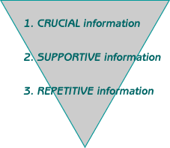
Importance of Structure
Reader’s expectation and interpretation
Topic position and Stress position

Slide 5
Outline
Main message: state what you have to say in one sentence.
Introduction (~2 points)
Relevant theory (~3 points)
Apparatus and method with a diagram (~ 3 points)
Analysis and discussion = your physics (~ 6 points & 2-4 figures)
Conclusion (~ 2 points)

Slide 6
Outline getting started

Slide 7
Step 1. Template with placeholders
Out-line is a tool for constructing a logically tight and effective article.
Placeholders allow one to focus first on items of higher priority.

Slide 8
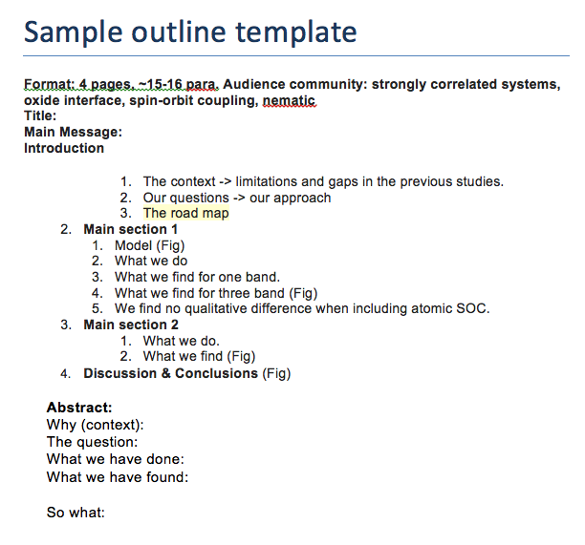
_{A template}

Slide 9
Step 2. Collect materials for the message
Results in key words, and data.
Figure and table sketches.
Preparing internal report ppt can be useful.

Slide 10
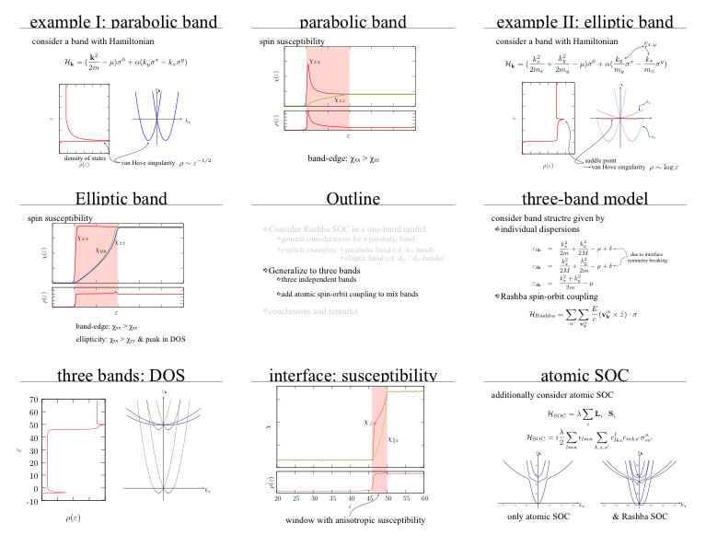
Example, Mark’s plots
Example Handout

Slide 11
Step 3. Draft message & questions
Identify readers.
‘Based on the material collected, draft the reader-appropriate message sentence.
Based on the message sentence, draft the reader-appropriate questions.

Slide 12
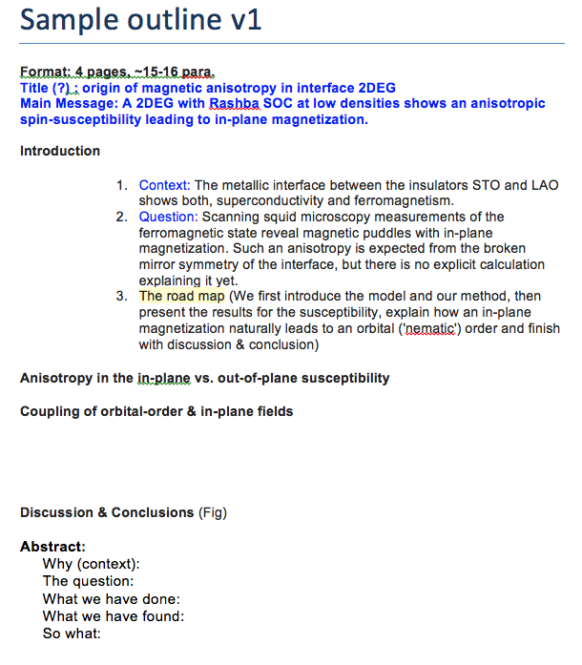

Slide 13
Step 3. Draft your results part
Select what to present from the collection of results.
Relate the results to the question posed and revise the message parts as necessary.

Slide 14
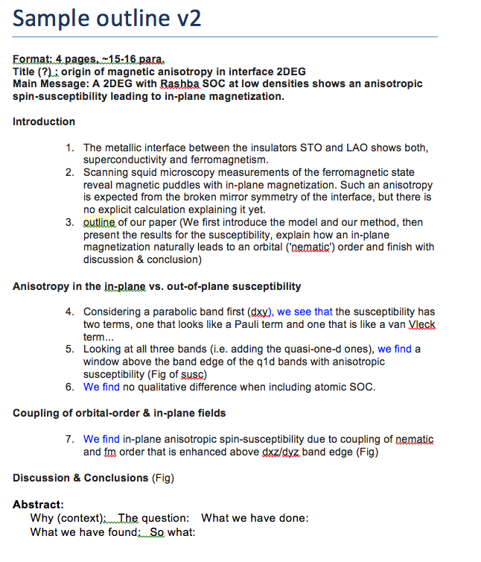

Slide 15
Step 4. Draft model part and context
Keep it reader oriented. Your readers should be able to relate to your starting point.
Watch out for logical gaps.
Keep it streamlined to what is minimally necessary to reproduce your results.

Slide 16
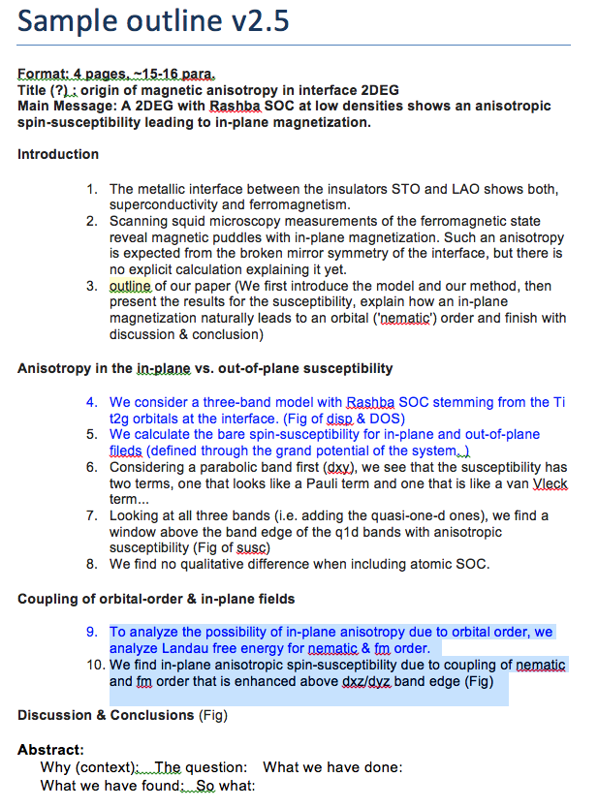

Slide 17
Outline <-> Abstract
Why: the background.
What: question asked.
How: experiments done.
What: key specific (quantitative) results found
Meaning: the answer to the question asked. Your main message!
So what: implications. Kicker.

Slide 18
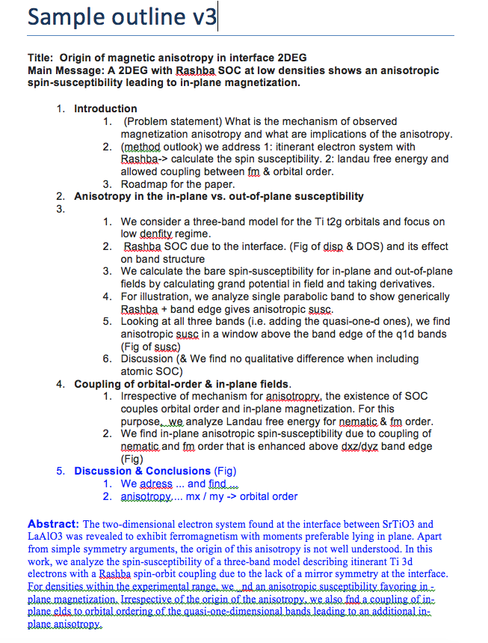

Slide 19
Comparison between v2.5 and v3
While writing the abstract, you will notice gaps in the logical flow.
You can go back to the outline and fill them in.
Result: A solid back-bone for a well structured paper.

Slide 20
Outline <-> Paragraphs
Outline bullet point = topic sentence + stress point
Structure of paragraph:
  Topic sentence
  Supporting material
  Stress sentence

Slide 21
Outline v3 vs Manuscript
Large structure anchored by figures.
Logical flow between paragraphs is visible from the outline.

Slide 22
Paragraph Organizational tips
1. Avoid a succession of loose sentences (monotonous).
2. Paragraph flow is helped by:
parallel sentence structures
logical flow of ideas
if necessary, transition words
3. Your reader remembers the first sentence and the last sentence best. Make the last sentence memorable. Emphasis at the end!

Slide 23
Homework
Rephrasing given phrases for bravity and clarity. Avoiding “overweight” issues.
Revising a paragraph.
Submit two choices of well written PRL’s that are important in your field.

